Slide 1

CENTURION UNIVERSITY OF TECHNOLOGY AND MANAGEMENT
ENGINEERING ECONOMIC AND COSTING
“BANKING STRUCTURES IN INDIA AND CHARACTERSTICS OF INDIAN BANKING SYSTEM”
MEMBERS:- 1.AYUSH MOHANTY
2.SIMRAN PATTNAIK
3.RUPALI PRADHAN
4.RAJAT RANJAN PATRO
5.BARSAPRIYADARSINI MOHAPATRA
6.ARPITA PRIYADARSINI SAHU
BY GROUP-: 7

Slide 2

INTRODUCTION
In 1969, the Government of India nationalised 14 major private banks; one of the big banks was Bank of India. In 1980, 6 more private banks were nationalised.^{[8]} These nationalised banks are the majority of lenders in the Indian economy. They dominate the banking sector because of their large size and widespread networks.
A bank is a financial institution that stores money and provides lending services. Banks are a key part of the economy because they help create and store money.
Banks perform a number of functions, including:
Accepting deposits
Lending money
Creating money

Slide 3
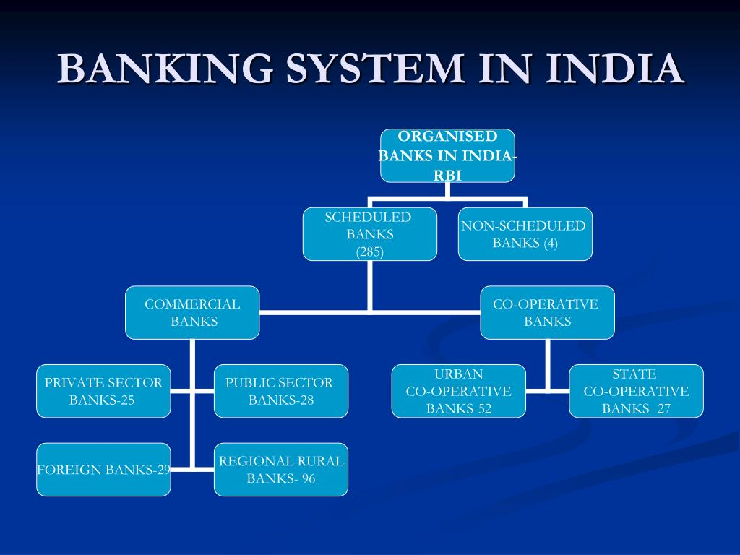


Slide 4
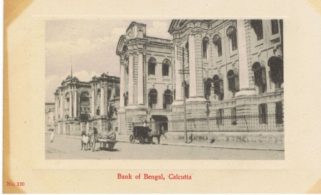
OVERVIEW OF INDIAN BANKING SYSTEM
The Indian Banking System includes commercial banks, regional rural banks, urban cooperative banks, and primary agricultural credit societies. India’s modern banking began in the 18th century. The State Bank of India is the biggest and oldest surviving bank. It began as the Bank of Calcutta in mid-June 1806. Today it is one of the largest lenders in the country. The Indian subcontinent reaped the benefits of a favourable trade balance, with exports outnumbering imports by wide percentages.
In India, three kinds of banks form the structure of the Indian banking system:
Scheduled Banks
Non-scheduled Banks
Development Financial Institutions or Development Banks
This Photo by Unknown Author is licensed under CC BY-SA-NC

Slide 5
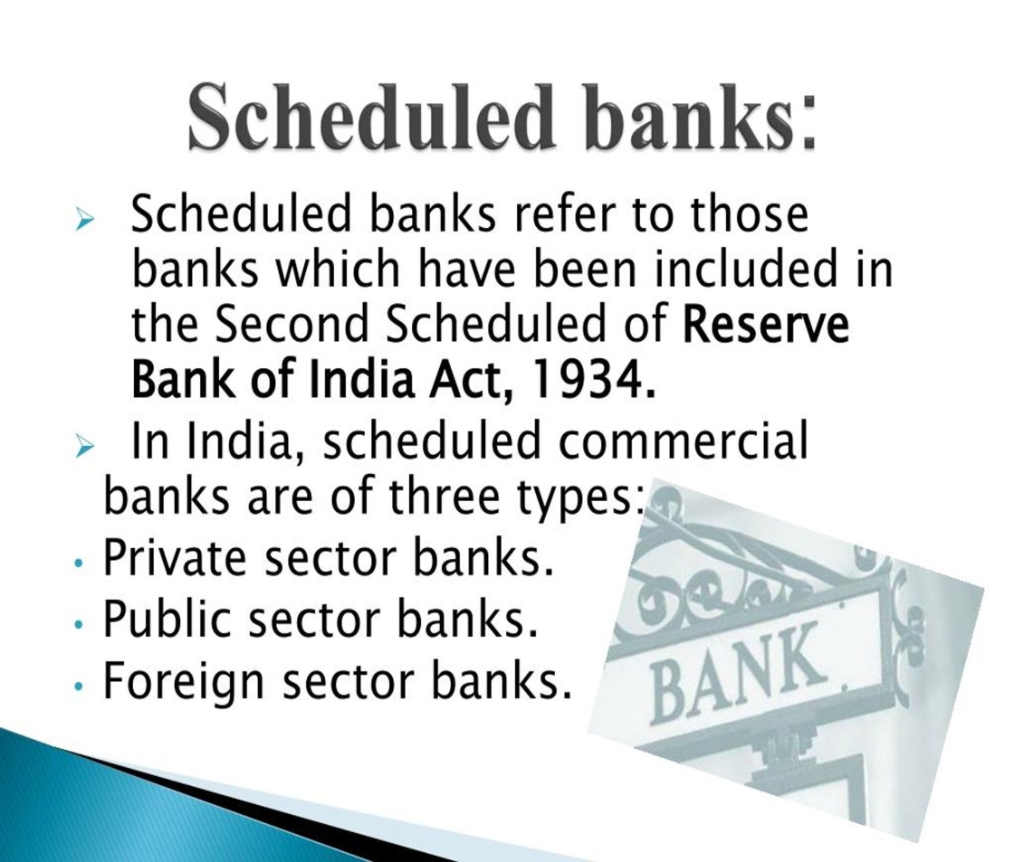

a). SCHEDULED BANKS

Slide 6
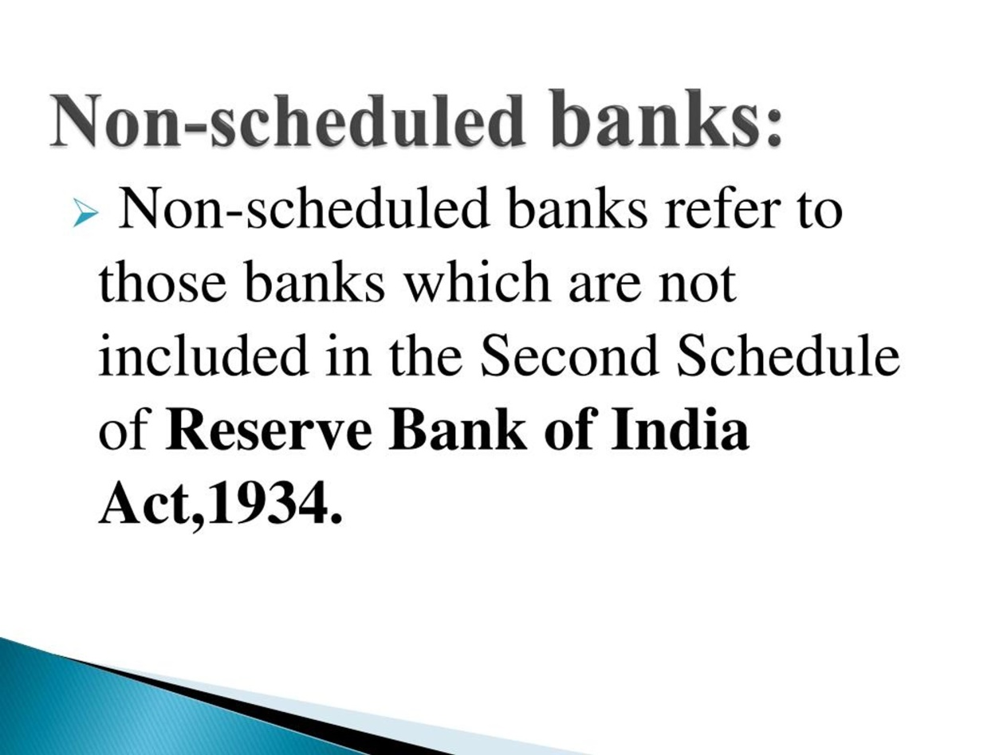
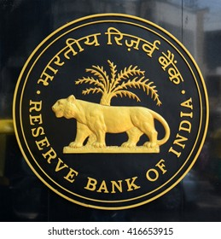
b). NON-SCHEDULED BANKS
Those banks which are not covered by the second section of the Reserve Bank of India Act, 1934. Except in times of crisis, they cannot borrow from the RBI for traditional banking purposes.

Slide 7
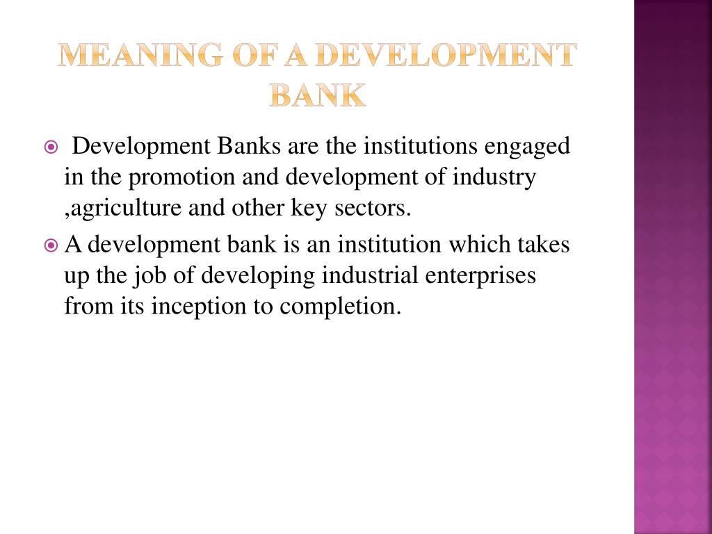
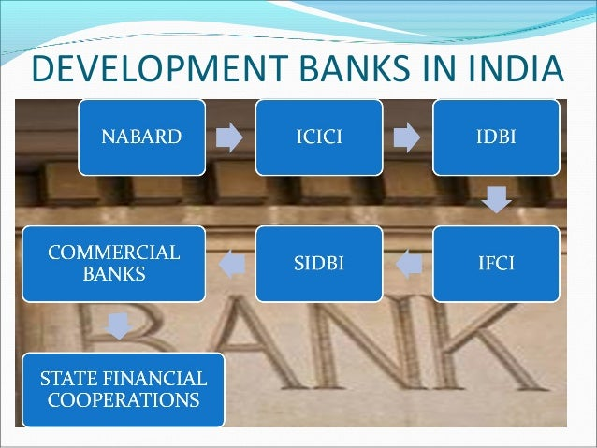

c). DEVELOPMENT BANKS

Slide 8

CHARACTERISTICS OF THE INDIAN BANKING SYSTEM
Deals with Money
The main characteristics of a bank is to handle all financial transactions like to deposit savings, lending loans etc.
Provides Loans
Banks gain additional money by providing loans for a various purposes like for education, housing, personal loans and so on.
Withdrawal and payment facilities
Bank provides payment and withdrawal facilities by the mean of cheques, ATM machines, Credit cards and debit cards
Internet services
Modern banks now provide internet services for numerous transactions with the use of UPI, netbanking and so on.
Business
Banking’s sole purpose is not to supply consumers with banking services but also get involved in many business in order to deliver optimum customer satisfaction and maximum interest rates.

Slide 9
REGULATION AND GOVERANCE OF INDIAN BANKS
      The Reserve Bank of India (RBI) is the primary regulatory authority for the banking sector in India. The RBI regulates banks and financial institutions to ensure the stability and transparency of the Indian financial system. The RBI's regulatory powers include:
Inspection and supervision
The RBI inspects and supervises commercial banks, cooperative banks, and non-banking financial companies (NBFCs).
Issuing rules and regulations
The RBI issues rules, regulations, directions, and guidelines on a wide range of banking and financial sector issues.
Regulating foreign exchange transactions
The RBI regulates transactions related to foreign exchange, current and capital account transactions.

Slide 10

RETAIL BANK OF INDIA
Retail banking in India is a type of banking that offers financial services to individual consumers, by Paying bills, Making home purchases and Depositing funds.
Retail banks in India are made for the needs of each client and are regulated by the government to provide safe and secure services. Some common types of retail banks in India include: Commercial banks and Credit unions
Retail banks offer a variety of services like Online banking, Mobile banking, ATMs, Debit and credit cards, and Overdrafts.

Slide 11

CORPORATE BANKINGN IN INDIA
It refers to the specialised banking services provided to large corporations, multinational companies and government entities.
Corporate banks offer a wide range of services like cash management, trade finance, treasury services, risk management and advisory services.
Corporate banks offer a wide range of specialized products and services designed specifically for corporations which include working capital finance solutions and overdraft facilities.
Corporate banks offer trade finance services like letters of credit (LC), bank guarantees and export-import financing.

Slide 12

FINANCIAL INCLUSION AND RURAL BANKING
Financial inclusion is the availability of financial services to all individuals and businesses, regardless of their personal circumstances.
Financial inclusion is a key enabler in reducing poverty and boosting prosperity accessing to basic financial services.
Rural banking refers to providing banking services to individuals living in rural areas.

Slide 13

CHALLENGERS AND OPPORTUNITIES FOR INDIAN BANKS
One of the biggest challenges facing the banking industry is regulatory changes which comply with various regulations, from anti-money laundering (AML) to data protection laws.
Top challenges in the banking and finance industry
Increasing competition. In today's financial landscape, competition is the name of the game. ...
Fraud. ...
A cultural shift. ...
Regulatory compliance. ...
Changing business models. ...
Rising expectations. ...
Customer retention. ...
Outdated mobile experience

Slide 14
CONCLUSION
The Indian banking system has evolved significantly over the years, shaping itself into a multi-layered and diverse structure that caters to the needs of a fast-growing economy. The key features of the Indian banking system include a well-established regulatory framework, driven primarily by the Reserve Bank of India (RBI), and a mix of public, private, and foreign banks. These banks provide a range of financial services from traditional banking to more complex financial products, making the system crucial for India's development.
The banking structure in India comprises:
Commercial Banks (Public, Private, and Foreign)
Cooperative Banks (Urban and Rural)

Slide 15
THANK YOU
WE HOPE U ALL LIKED AND LOVED OUR PRESENTATION

